Slide 1
E-commerce Business Analysis
By: Udeme Umana

Slide 2
Table Of Content
Introduction
Procedures and tools used
Entity Relational Diagram
Data observation with Sql
Business questions and Problems
Conclusion

Slide 3
Overview
This project contains datasets that were developed by me from scratch. The main objective of this project is to use data to answer real life business problems. The dataset consists of the following files: Customer_data, Employee_data, job_info, order, product, sales stored procedures, functions and a view.
Link to my SQL codes
Project Case:
I was appointed a data analyst for Udy_Xpress which is an e-commerce company. They have recently invested in a new technology and are keen to migrate their data into this new capability.
They currently maintain a suite of excel files, which they want to migrate onto a dedicated MYSQL Database. Furthermore, they want to leverage data as a source of information and will also want me to lead on the reporting process of this project.

Slide 4
Procedures and tools used
I focused on cleaning the data, adding new columns where necessary and importing the dataset into MySQL Workbench. I modified each unique keys for each table to a varchar(12) and later converted them into primary and foreign keys in order to get the entity relational diagram. Then I conducted Exploratory data analysis on the datasets before writing queries to answer various business problems.

Slide 5
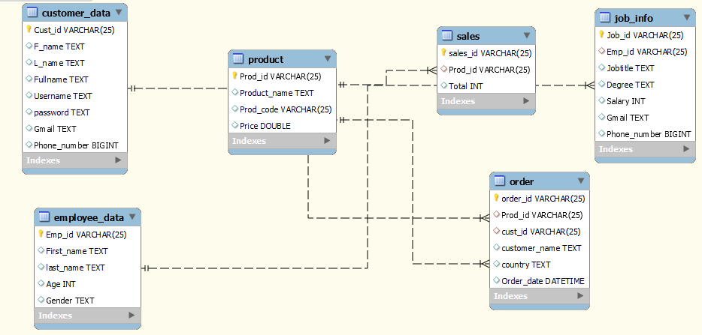
Entity Relational Diagram

Slide 6
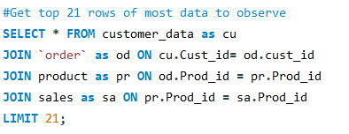
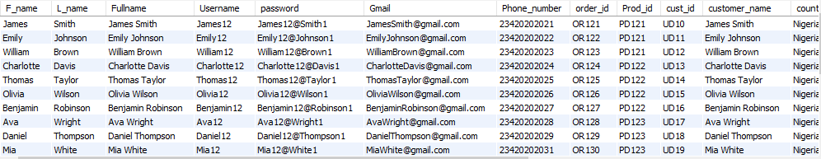
Data Observation With SQL
The tables were imported into Udy_Xpress database in MySQL Workbench, then I wrote queries to interact with the data.

Slide 7
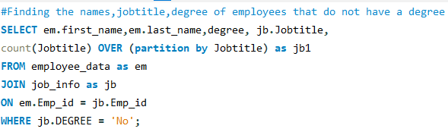
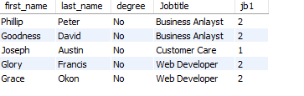
Business Questions
Your company is having a layoff and your boss tells you create a list of employees that does not have a degree.

Slide 8
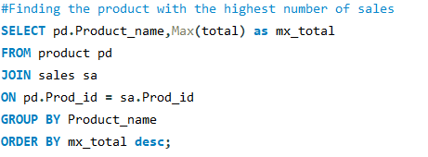
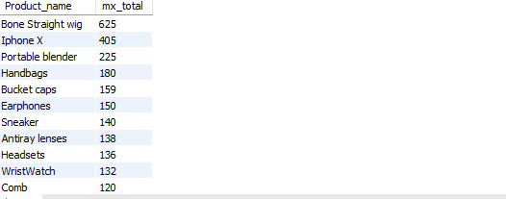
Business Questions
My boss wants to know the product that generated the most sales from the data we have.

Slide 9
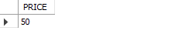
Business Problem
With my experience working as a data analyst at Udy_xpress, I noticed that in order to get the price of a product you have to manually search for the product code and price from the database. So I created a stored procedure that gives you the price of product when you input the product code(This is similar to scanning of a product barcode to get the price). Below is an illustration of me inputting the product code and getting the price.

Slide 10
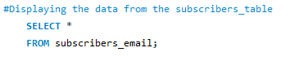
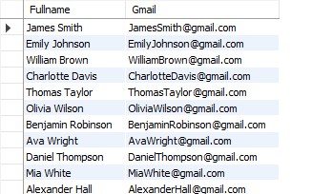
Business Questions
I was asked to create a database where the names and emails of customers who subscribed to be receiving weekly newsletters are stored.
So I decided to create a view, The reason for using a view is each time a customer signs up and registers to be receiving weekly newsletters on the company’s website, their information is being saved in the customer table and it’ll automatically be added to the subscribers_table.

Slide 11
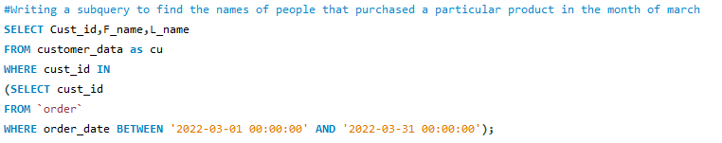
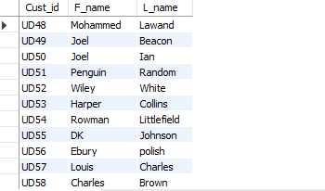
Business Questions
In the month of march the company had a problem with the price software and it overcharged people that placed orders. I was asked to create a list of people that purchased a product/products in the month of march.
The main aim of doing this is to enable the company know the people that made a purchase during that period so that a refund can be given to them.

Slide 12
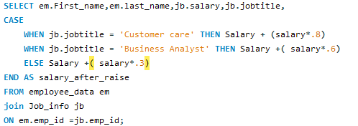
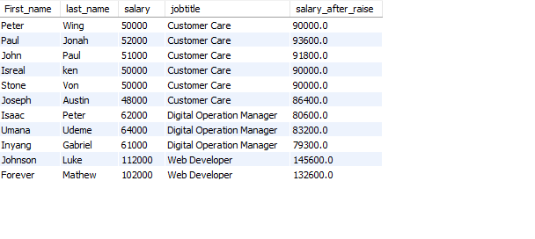
Business Questions
Business analysts and customer_care has done well in their jobs and I was asked to give them 0.6 raise for business analyst and 0.8 raise for customer care and give the rest 0.3 raise.

Slide 13
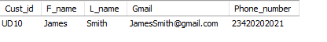
Business Problem
So before udy_express website launched I created a stored procedure that’ll allow customers to access their information from the database using their username and password. Below shows the user inputting his login details as well as his information being displayed:

Slide 14
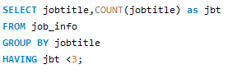
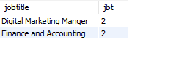
Business questions
The manager realised that some departments are short staffed and wants you to find the job title with less than 3 people working so that he can hire more people to work in that department:

Slide 15
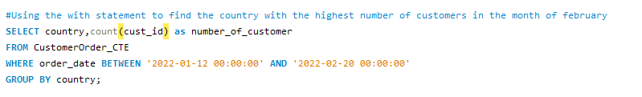
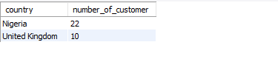
Business Problem
I realized that I usually need to find the cust_id, country and order date from Udy_Xpress database on a daily basis, so I created a CTE to store the query in order for me to be able to run it with few lines of codes.
I was asked to find the country with the highest customers in the month of February as seen below:

Slide 16
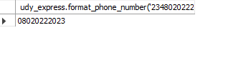
Business Problem
I decided to write a function in SQL to format a number that has a Nigerian country code. It removes the country code and adds 0 in place of it. (This was just a bonus query)

Slide 17
Conclusion
I was able to understand the concept of databases as well as foreign keys and primary keys.
I understood how to join multiple tables and how it worked.
I was able to know more about the functionalities of a stored procedure.
For records that you need to update on a regular basis, Views is more suitable to use.
Lastly, I was able to understand how to use functions and its syntax.
SQL codes

Slide 18

Thank you!

